Slide 1


Yelp Project
Collecting and Analyzing Large Data
Team 5:
Xiang Gao
Siqi Hu
Alexander Ilyin
Ziyuan Yan
MGTA 452
Notes:
Hey, class. This is Team 5. I’m Bruce. In our team, we have Stella, Alex, and, Esther. The topic for our project is how can a business owner pinpoint business opportunity by looking and analyzing data from Yelp.com.

Slide 2
C ONTENTS
01. Introduction
02. App Demo
03. Detailed Analysis
02. Conclusion
Notes:
We divided our presentation into 4 sections today. I will first introduce you into our proposal and data. From there, Alex will take over to demo an app we built based on these data. Next, we have Stella and Esther to walk you through our detailed analysis. And I will conclude with business insights and opportunity. Without further adu, let’s jump into our project.

Slide 3

Yelp Project
1
Introduction
Introduction
App Demo
Detailed Analysis
Conclusion
4
Notes:
How we decide this topic? We first came up with a business question: if we were business owners, how can we find the best business opportunity in a chosen city? The data from yelp help us address this problem. (Interesting, close to our everyday life, plenty of data to dig from.

Slide 4
Proposal and Business Problem
We want to build a platform that draws insights from the data and help new business owners plan their market entry strategy.
What?
Where?
Introduction
Introduction
Issues to Solve
Empirical Studies
Conclusion
App Demo
Detailed Analysis
Causes
4
4
Notes:
With that, we came up with our proposal: we want to build a platform that draws insights from the data and help new business owners plan their market entry strategy. And our specific business problems are what business to choose and where to open?

Slide 5
Yelp Business:
174,567 entries,
13 total columns
Yelp Review:
5,261,668 entries, 9 total columns
Business_id, name, neighborhood, address, city, state, postal_code, latitude, longitude, starts, review_count, is_open, category
Dataset
Overview
Review_id, user_id, business_id, stars, date, text, useful, funny, cool
Introduction
Introduction
Issues to Solve
Causes
Empirical Studies
Conclusion
App Demo
Detailed Analysis
4
4
Notes:
With these goals and questions, we found two sets of data: Yelp business, and yelp review.

Slide 6
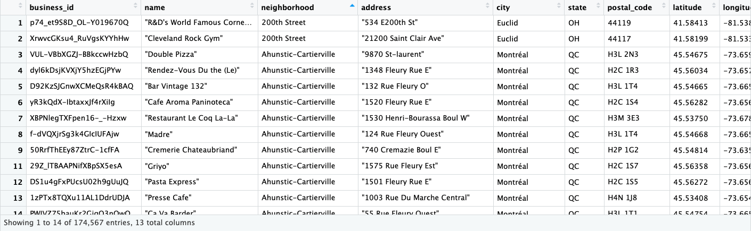
Dataset Overview: Yelp Business
Introduction
Introduction
Issues to Solve
Causes
Empirical Studies
Conclusion
App Demo
Detailed Analysis
4
4
Notes:
Here is a screenshot for our business data in a table format.

Slide 7
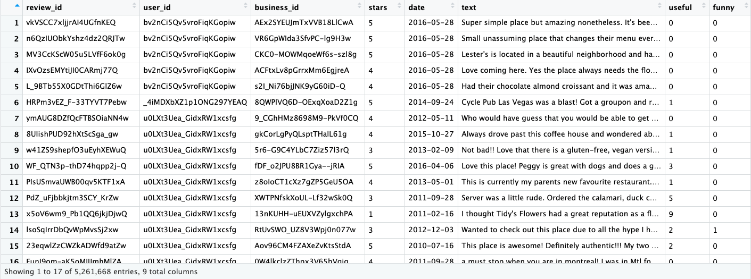
Dataset Overview: Yelp Review
Introduction
Introduction
Issues to Solve
Causes
Empirical Studies
Conclusion
App Demo
Detailed Analysis
4
4
Notes:
Here is a screenshot for our review data in a table format.

Slide 8

Data Cleaning
combine business and reviews b
Filter cities that have more than 1000 businesses
Filter reviews after 2015 (Oldest review year: 2004)
Add categories: Business type or Cuisine
Combine two datasets
Introduction
Introduction
Issues to Solve
Causes
Empirical Studies
Conclusion
App Demo
Detailed Analysis
4
4
Notes:
These data looked messy at first, so we thought we should do data cleaning.
The criteria are set as follow: …
… with a clear proposal and data cleaned, we move to build an app to show findings, Alex will take over to demonstrate you our app.

Slide 9
Yelp Project
2
App Demo
Introduction
Detailed Analysis
Conclusion
App Demo
4
Notes:
This is our yelp data visualization app, created using the R package shiny. We felt that shiny was a good way to create an interactive visualization tool for prospective business owners, rather than just looking through boring graphs. On the first page of the app is an interactive map. Using the dropdown menu, the user can select a city and category of business to view. Once the city and business type is selected, all matching businesses will be displayed. When clicking on the business, you can see the name, address, star rating, review count and the category of the business. For some businesses this map is a bit too cluttered, so using the other tools on the site may be more useful. Switching over to the next tab, we have a general overview of average rating and review count by business type in each city. As you can see, restaurants are the most reviewed and usually have the highest rating, so we decided to continue or analysis on only restaurants. The heat map tab shows the distribution of each category of business throughout the city. Obviously, the more of each business in a certain part of the city, the darker shaded the region will be. The next tab, titled restaurant visualization, is our in depth analysis of restaurants. The first tab is just a general visualization of restaurant types. To find the top 5 cuisines, we completed a word frequency analysis of categories, in order to find which words occurred the most. These words happened to be American, Mexican, Japanese, Chinese and Italian which is expected. The bar chart to the left shows the popularity of all the cuisines we encountered in this dataset, measured by how many reviews were associated with each. The pie chart to the right shows the popularity of restaurants by quantity. Finally, this plot below is a k-means clustering of restaurants by neighborhood. The dataset provided a column for neighborhoods in each city, and this k-means clustering algorithm attempts to recreate the neighborhoods in the selected city. Finally, there is an extension of the previous heatmap, which shows the distribution of restaurants by cuisine. The last tab of this app is a text analysis of restaurant reviews. We took the top 5 cuisines and found their positive and negative sentiments. We then visualized these sentiments. Finally, we created a word cloud for all restaurants by city.

Slide 10
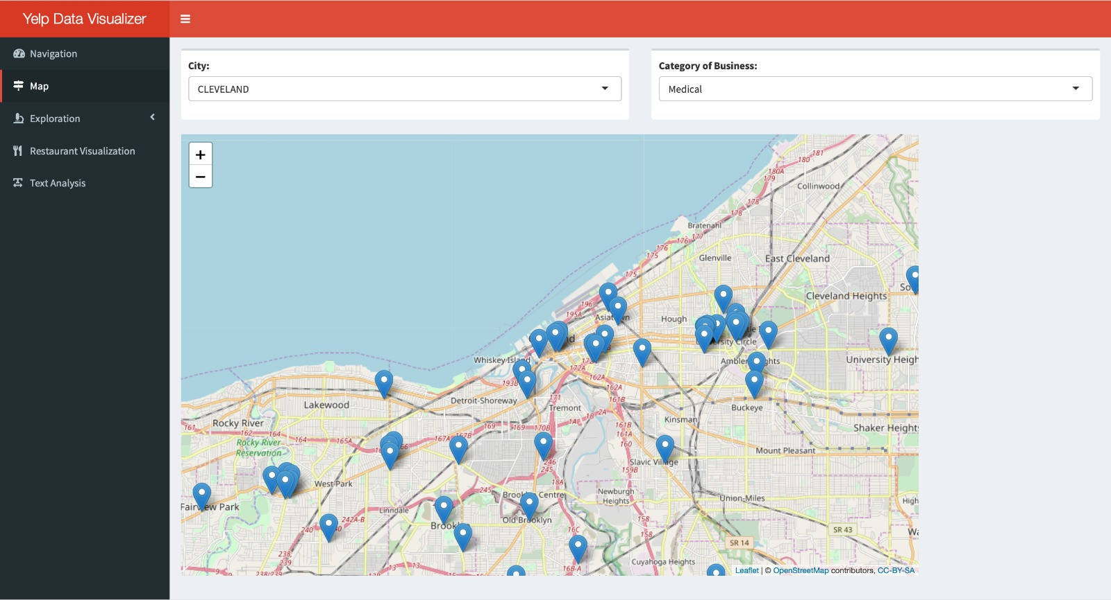
An App We Built
Home Page / Map View:
This page allows the current user of the application to visualize businesses in each available city by business category. The purpose of this page is a general overview of the distribution of business within each city represented in the dataset. If the prospective business owner has not chosen what type of business he wants to open, this map will help him understand the location of his future competitors, as well as their star ratings.
Introduction
Detailed Analysis
Conclusion
App Demo
4
Notes:
This is our yelp data visualization app, created using the R package shiny. We felt that shiny was a good way to create an interactive visualization tool for prospective business owners, rather than just looking through boring graphs. On the first page of the app is an interactive map. Using the dropdown menu, the user can select a city and category of business to view. Once the city and business type is selected, all matching businesses will be displayed. When clicking on the business, you can see the name, address, star rating, review count and the category of the business. For some businesses this map is a bit too cluttered, so using the other tools on the site may be more useful. Switching over to the next tab, we have a general overview of average rating and review count by business type in each city. As you can see, restaurants are the most reviewed and usually have the highest rating, so we decided to continue or analysis on only restaurants. The heat map tab shows the distribution of each category of business throughout the city. Obviously, the more of each business in a certain part of the city, the darker shaded the region will be. The next tab, titled restaurant visualization, is our in depth analysis of restaurants. The first tab is just a general visualization of restaurant types. To find the top 5 cuisines, we completed a word frequency analysis of categories, in order to find which words occurred the most. These words happened to be American, Mexican, Japanese, Chinese and Italian which is expected. The bar chart to the left shows the popularity of all the cuisines we encountered in this dataset, measured by how many reviews were associated with each. The pie chart to the right shows the popularity of restaurants by quantity. Finally, this plot below is a k-means clustering of restaurants by neighborhood. The dataset provided a column for neighborhoods in each city, and this k-means clustering algorithm attempts to recreate the neighborhoods in the selected city. Finally, there is an extension of the previous heatmap, which shows the distribution of restaurants by cuisine. The last tab of this app is a text analysis of restaurant reviews. We took the top 5 cuisines and found their positive and negative sentiments. We then visualized these sentiments. Finally, we created a word cloud for all restaurants by city.

Slide 11
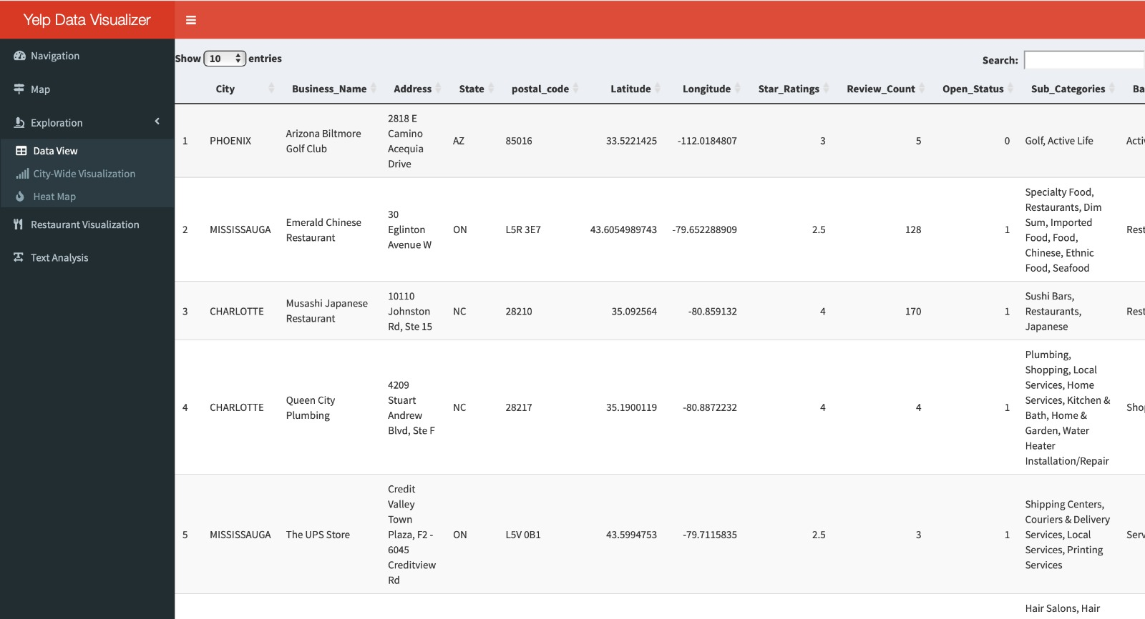
Introduction
Detailed Analysis
Conclusion
App Demo
4

Slide 12
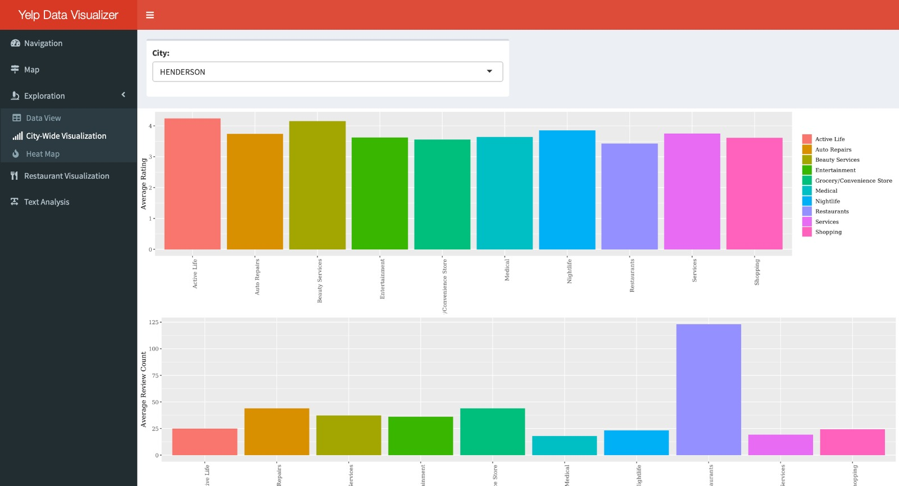
An App We Built
City Wide Rating and Review Count Distribution:
After viewing the location of competitive business
Introduction
Detailed Analysis
Conclusion
App Demo
4

Slide 13
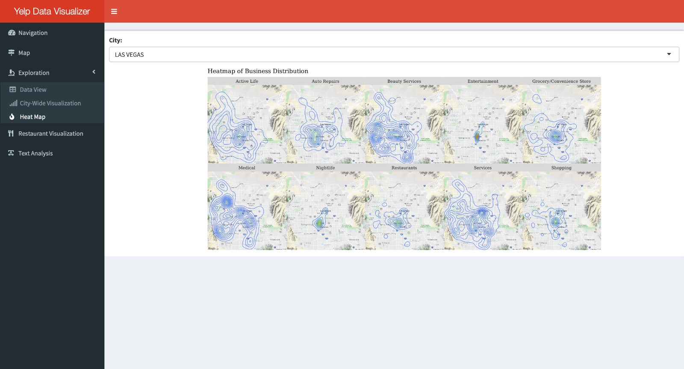
Introduction
Detailed Analysis
Conclusion
App Demo
4

Slide 14
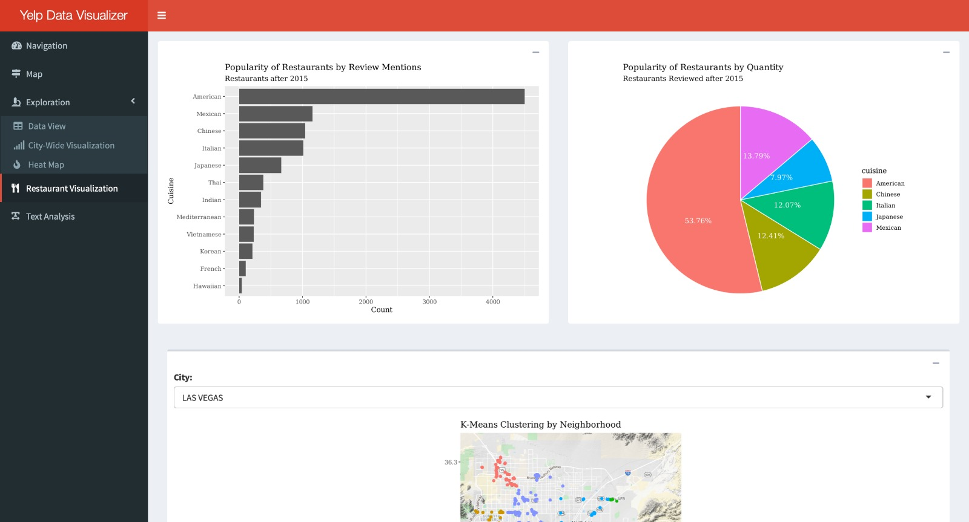
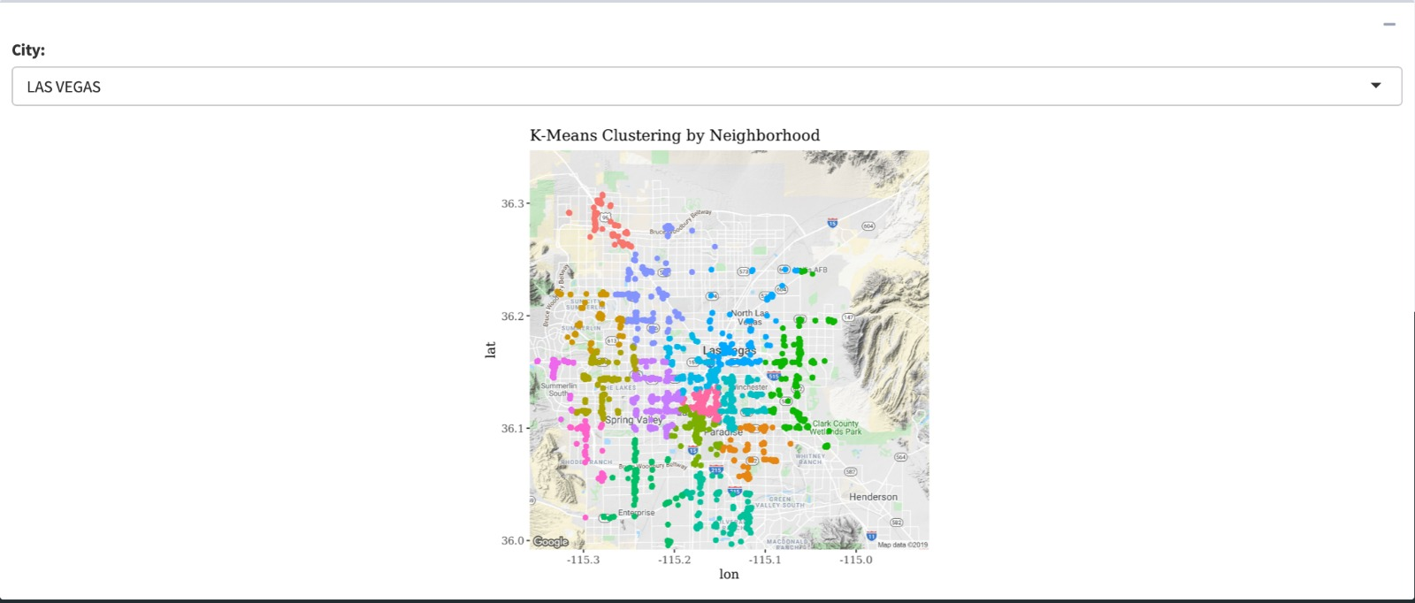
Introduction
Detailed Analysis
Conclusion
App Demo
4

Slide 15
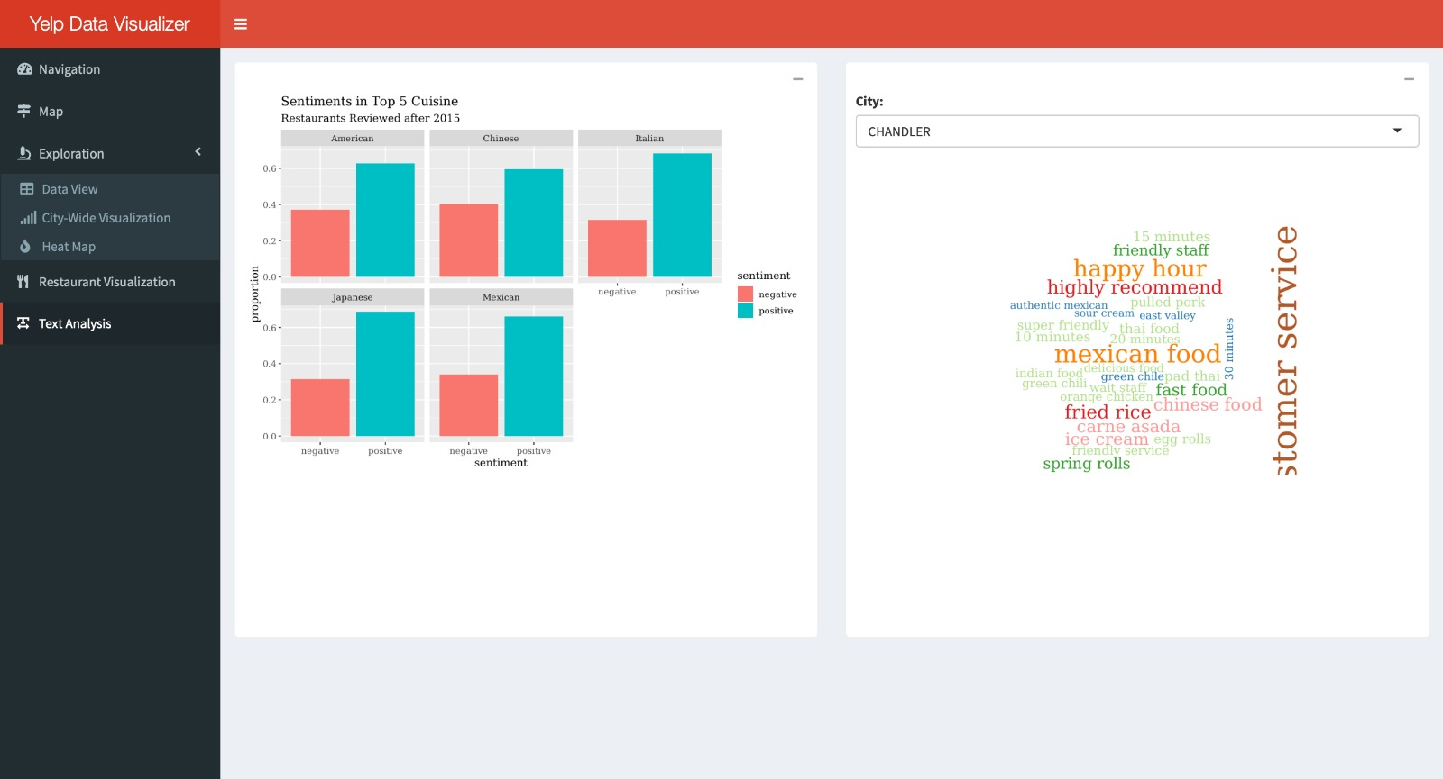
Introduction
Detailed Analysis
Conclusion
App Demo
4

Slide 16

Yelp Project
3
Detailed Analysis:
Las Vegas Restaurants
Introduction
App Demo
Detailed Analysis
Empirical Studies
4
Conclusion
Notes:
Now, we will focus on one city and one business for a more in-depth analysis. We chose Restaurants in Las Vegas after 2015.

Slide 17
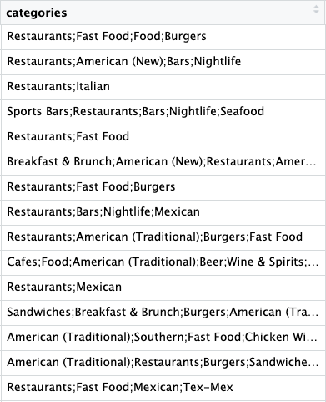
What
Cuisines
to Offer?
Our Categories:
American,
Mexican,
Chinese,
Italian,
Japanese,
Thai,
Mediterranean,
Hawaiian,
Korean,
Vietnamese,
French,
Indian,
Irish,
German,
Russian
Introduction
Empirical Studies
International Stock M
Introduction
App Demo
Detailed Analysis
Conclusion
Issues to Solve
Issue to solve
Empirical Studies
Conclusion
Causes
4
4
4
Notes:
The first problem we want to solve is what type of restaurants we want to open. Let’s take a look at the category column of our data. It contains tons of information, but it’s really messy. The first thing we did is re-categorizing restaurants according to different cuisine types. These are the 15 most popular cuisines around the world.

Slide 18
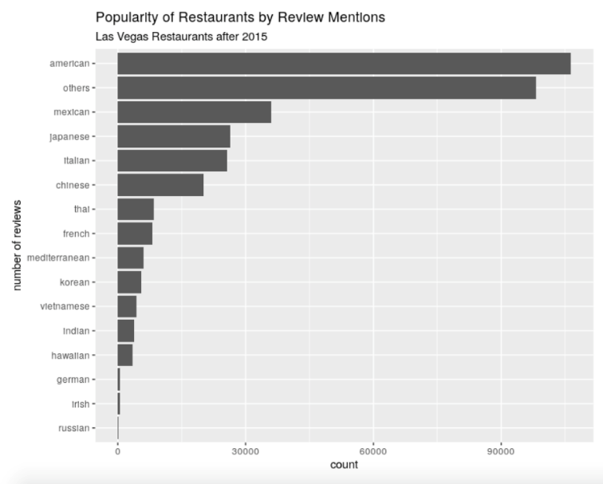
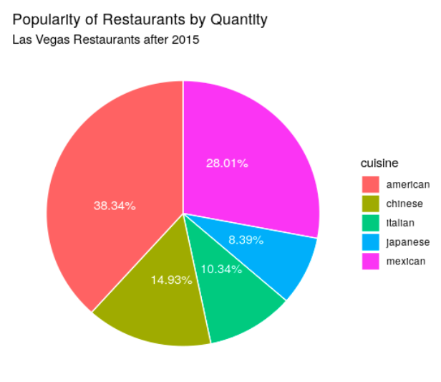
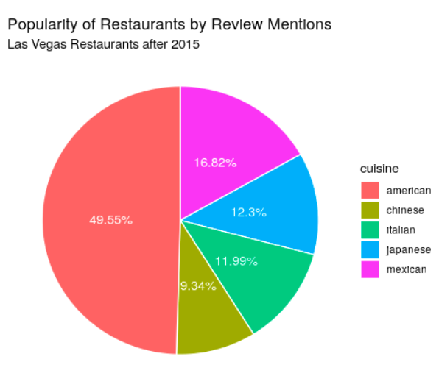
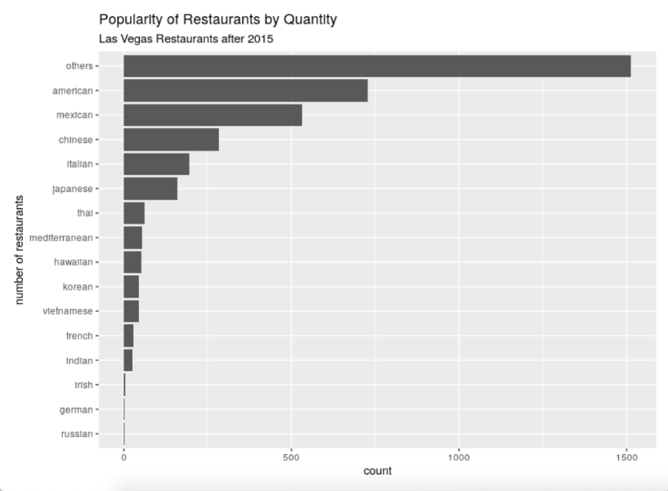
What Type of Restaurant?
Introduction
Empirical Studies
International Stock M
Introduction
App Demo
Detailed Analysis
Conclusion
Issues to Solve
Issue to solve
Empirical Studies
Conclusion
Causes
4
4
4
Notes:
Picture 1:
These are the visualizations we did after categorizing. Although we already tried to categorize the restaurants as specific as possible, there is still a huge amount of “others”. (But don’t worry we’ll deal with it later)
If we look at the first picture, which is Popularity of Restaurants by Quantity, the top ones are American, Mexican, Chinese, Italian, and Japanese.
Pictures 2:
The Top 5 cuisines are the same when we look at Popularity of Restaurants by Review Mentions, which is more like the demand side of this industry.
Picture 3:
We continued to do our further analysis on the Top 5 Cuisines. As you can see on this pie chart, American cuisine has a market share of about 38%
Picture 4:
Demand side is even larger, it’s almost 50%.

Slide 19
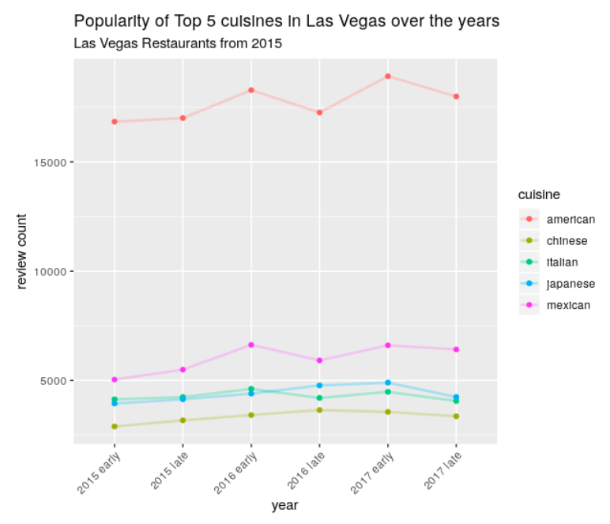
What Type of Restaurant?
Introduction
Empirical Studies
International Stock M
Introduction
App Demo
Detailed Analysis
Conclusion
Issues to Solve
Issue to solve
Empirical Studies
Conclusion
Causes
4
4
4
Notes:
We also made a line chart on the popularity of Top 5 cuisines over the years using the review count. Although there are some fluctuations, popularity generally maintains on a constant level, rises a little bit for American and Mexican

Slide 20
What Type of Restaurant?
Other information in Categories
?
✓
Text Analysis of
Categories
Review Text
Introduction
Empirical Studies
International Stock M
Introduction
App Demo
Detailed Analysis
Conclusion
Issues to Solve
Issue to solve
Empirical Studies
Conclusion
Causes
4
4
4
Notes:
We got the previous findings after splitting those restaurants into a couple of categories according to the cuisines they provide. In this way, we are afraid that we may miss some information from the data of the Categories column. Therefore, we decide to find out the words with the highest frequency of occurrences, to see whether they can give us some insights into people’s preferences and demands.

Slide 21
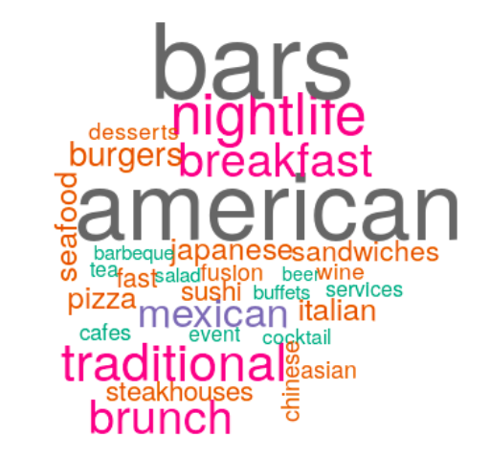
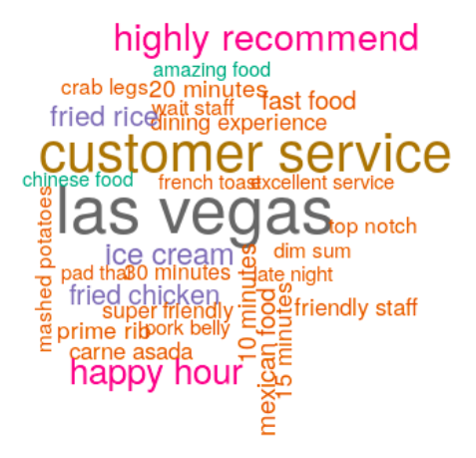
What Type of Restaurant?
Top 30 words in Categories
Top 30 bigrams in Review Text
Introduction
Empirical Studies
International Stock M
Introduction
App Demo
Detailed Analysis
Conclusion
Issues to Solve
Issue to solve
Empirical Studies
Conclusion
Causes
4
4
4
Notes:
We use word clouds to visualize the results. This is the top 30 words in Categories. Honestly, we were not surprised by the results, since words like “bars”, “brunch”, and “night life” consist with the image of Las Vegas, and our preliminary idea to open a restaurant offering American cuisines is proved by the big “American”. So we can say, a bar providing American cuisines might be a good idea. Similarly, in order to dig for information from review texts, we found the top 30 bigrams after deleting the stop words. From the results, we realized that customer service matters for customers in Las Vegas and the waiting time is frequently mentioned in reviews. Based on this, we recommend that the management team should take these two factors into consideration when making market positioning strategies.

Slide 22
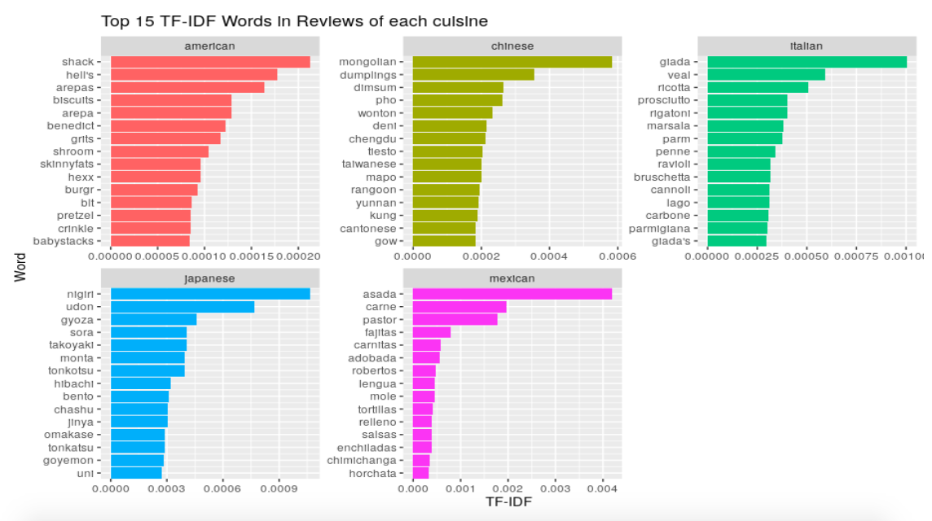
What Type of Restaurant?
Introduction
Empirical Studies
International Stock M
Introduction
App Demo
Detailed Analysis
Conclusion
Issues to Solve
Issue to solve
Empirical Studies
Conclusion
Causes
4
4
4
Notes:
When the type of restaurant is decided, picking out the words with highest tf-idf values can tell us the popular dishes in each type of cuisines, because this counting method eliminate the effect of those words that appear in each group. Therefore, the results may help a bit in menu design.
Reaching this stage, now we are gonna decide where to locate.

Slide 23
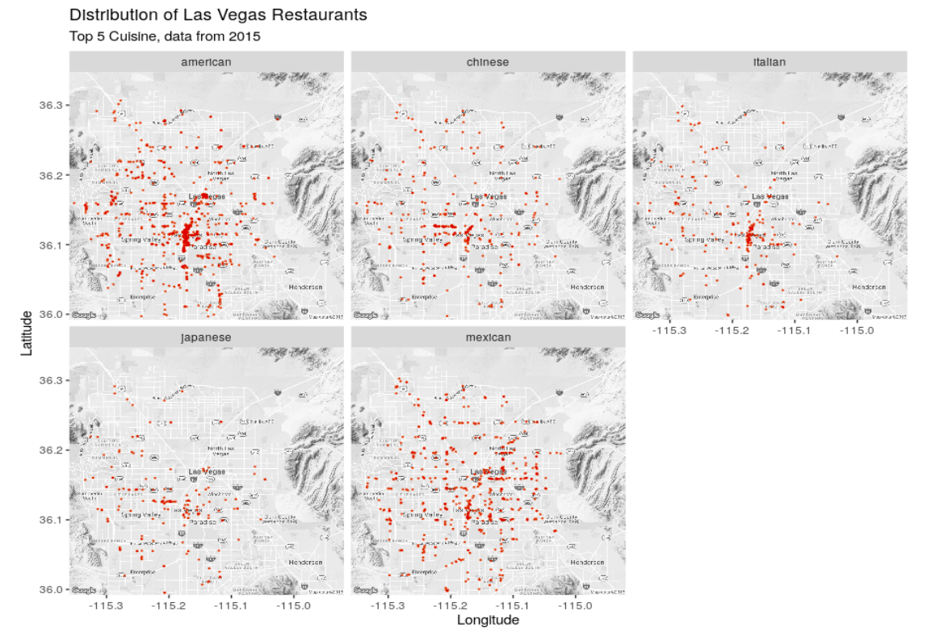
Where to
locate?
Introduction
Empirical Studies
International Stock M
Introduction
App Demo
Detailed Analysis
Conclusion
Issues to Solve
Issue to solve
Empirical Studies
Conclusion
Causes
4
4
4
Notes:
Now we want to address another question: Where to locate the restaurant?
We visualized the distribution of different cuisines on the map.
Every cuisine is concentrated in the Strip
American restaurants are almost everywhere, it also have a concentration in Downtown
Chinese restaurants: Chinatown
Japanese: Chinatown
Mexican: a lot, spread across the city, concentrate in east

Slide 24
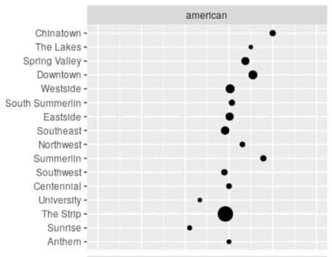
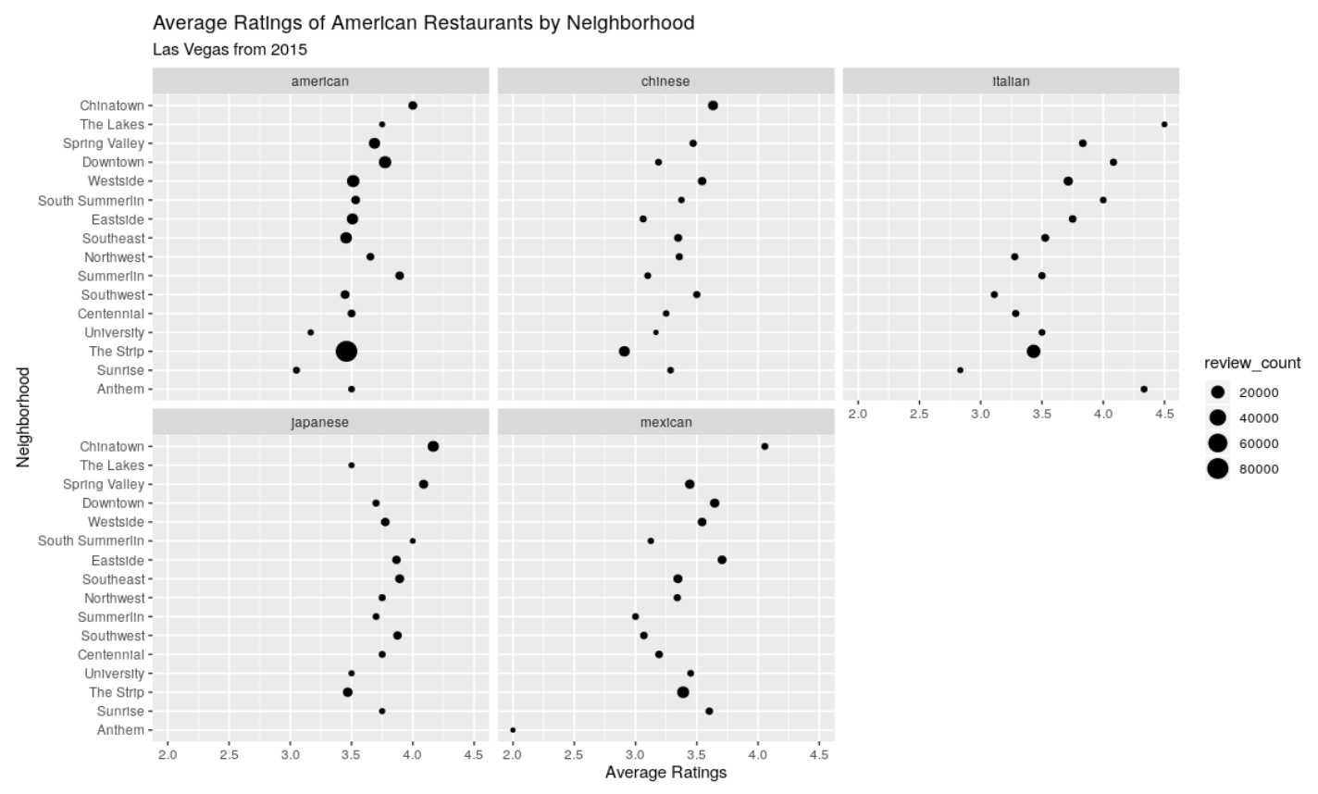
Where to
locate?
Introduction
Empirical Studies
International Stock M
Introduction
App Demo
Detailed Analysis
Conclusion
Issues to Solve
Issue to solve
Empirical Studies
Conclusion
Causes
4
4
4
Notes:
Together with the previous maps which show the geographical locations of restaurants, a map combining the number of restaurants with average ratings in each neighborhood gives us more insights. Our rationale is that a neighborhood with high demands while competitors not performing well has more opportunities for a newly started business. That is, we may not want to take part in the competition with small circles on the right side of the graphs. For example, looking at American restaurants alone, we can tell that it’s probably not a good idea to open an American restaurant in Chinatown, Summerlin, or Northwest, where the demand is not high and customers are generally satisfied with the existing restaurants.
Now Bruce will wrap up our findings.

Slide 25

Yelp Project
4
Conclusion
Introduction
App Demo
Detailed Analysis
Conclusion
4
Notes:
Thank you Stella. With all these analysis, we are finally able to arrive at business insights to help us answer the business problem we have.

Slide 26

Business Insights from Yelp data
Yelp data provide us edgy on current market competition landscape
Assist business owners positioning and tailoring what to offer by specific customer demands
Ideal customer experience
Introduction
App Demo
Detailed Analysis
Conclusion
4
Notes:
The data provided us an edgy on understanding the current market competition landscape, what needs are hotly discussed and what are neglectable. The analysis from data assist business owners positioning and tailoring what to offer by specific customer demands. We also learned what an Ideal customer experience looked like from consumers’ perspectives: we should focus on customer service with friendly staff, and going back to this chart(where to locate), there is hug clustering in rating of 3.5, we should aim to provide above 3.5/5 dining experience by looking at how these restaurant did well.

Slide 27

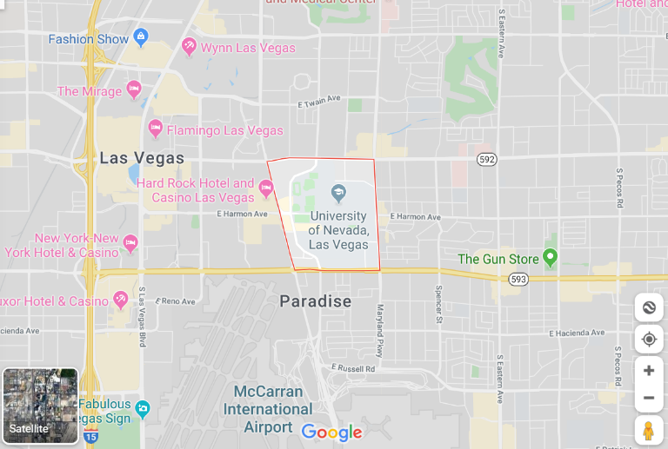
Business Opportunity in Las Vegas city
Based on our data*
What restaurant?
- A bar offering American cuisine
Where to open?
- The University district
Introduction
App Demo
Detailed Analysis
Conclusion
4
Notes:
Moving into business opportunity in a city we choose: Las Vegas, from our analysis, we are confident to claim that opening an American cuisined bar restaurant at the University district by taking advantages of the business insights we found, this business would standout the competition and provide customers there the experience they long wanted and become successful.

Slide 28
Yelp Project
THANK YOU
Q & A
Notes:
With that, I will conclude our presentation and open the floor for Q&A. Thank you for your time and patience.

